Slide 1

Speak Fluently & Confidently A2- Course 1

Slide 2
Session 2- Talking about Family
Part 1-: My English Family ( Listening)
Part 2: What would you say in the following
situations? ( More Idioms & collocations)
Part 3: Speaking Practice
https://befluent.me/

Slide 3
Session 2- Talking about Family
Part 1-: My English Family
( Listening )
https://befluent.me/

Slide 4
Script:
Todd: So, Katie, let's talk about family.
Katie: Okay.
Todd: In your family, who is nice?
Katie: In my family, I think my, my mum is really nice. She's always looking out for everyone. She always makes sure everybody is happy. And she's just really nice and kind.
Todd: Wow! That's great. Who is a funny person? Who is very funny?
Katie: I think in my family; my dad is very funny. But I don't think he knows he's very funny.
Todd: Alright. Oh, that's interesting. Now who is serious? Is anybody serious?
Katie: I don't think anybody is serious in my family.
Todd: No uncles or aunts?
Katie: Everyone likes to have a laugh. Everyone likes to have a good time.
Todd: Oh that-

Slide 5
Script:
Katie: Everyone is always joking.
Todd: Oh, what I nice family.
Katie: (laughs)
Todd: OK. Who is very hardworking?
Katie: Ooohh. Well obviously, my mum is very hardworking. And she's always been very hardworking. She has to make sure that the whole family knows what they're doing. She has to make sure the whole family is ready for every day. Yeah, I think my mum is the hardworking one.
Todd: OK. Is anybody not hardworking? Maybe a little lazy?
Katie: Definitely me. (laughs) Definitely me especially when I was younger. I would never help with any of the chores in the house. I was definitely the lazy one.
Todd: Oh, I understand, I'm the same way. OK. Now in your family, who is very smart?
Katie: My brother is really, really smart. He actually went to Oxford University.
Todd: Whoa.

Slide 6
Script:
Katie: Yeah, he's very smart. But I didn't get any of that. My brother has all the smart genes.
Todd: Wow, that's a good school. OK. Who is very fit?
Katie: Hmm... Well, my dad is a chef and-
Todd: Oh, really?
Katie: Yeah. My dad makes really, really good food, so no one in my family is fit. We all eat too much food.
Todd: Oh, nobody exercises a lot?
Katie: Not really.
Todd: Oh, okay. Yeah, in my family, my dad is super fit.
Katie: (laugh)
Todd: OK. In your family, who is talkative?
Katie: Oh, I keep saying my mum for all of these but my mum is definitely the most talkative. She talks to anybody who - even people who she doesn't know. She will talk to anybody, strangers on the street, people she meets at the bus stop. She talks to everybody.

Slide 7
Script:
Todd: Oh, that's cool. Now, who is quiet?
Katie: Hmm, I think when he's meeting people for the first time, my brother is very quiet. He's very shy. He doesn't like speaking to new people a lot.
Todd: OK. Thanks a lot. Sounds like a nice family.
Katie: Yeah. I think so too.

Slide 10
Vocabulary Quiz
l
looking out for • obviously • chores gene • fit • strangers
He runs every day. He is very .
My dad is always out for me.
He is not happy. He looks mad.
You can meet when you travel.
He has the smart in the family.
I did not finish all my .

Slide 13
Session 2- Talking about Family
Part 2: What would you say in the following
situations? ( More Idioms & collocations)
https://befluent.me/

Slide 14
Session 2- Talking about Family
Like Father, Like Son
Meaning: Sons inherit their fathers’ traits and preferences, often even without realizing it.
Example: John was a great fisherman, and there’s his son Matt out on the water. Like father, like son.
Run in the Family
Meaning: Be inherited (as a trait) by multiple members of a family
Example: I’m not surprised Maria has started playing in a band. Musical talent runs in her family.
One Big Happy Family
Meaning: A group of people who live or work together or in close proximity
Family Man
Meaning: A man devoted to taking care of his wife and children
A Helicopter Parent
Meaning: a parent who overprotects and overcontrols their children, hovering around like a helicopter and monitoring everything that the children do
Example: His mum was a real helicopter parent and sent instructions to the kitchen on how to cook her son’s rice for every meal.
https://befluent.me/

Slide 15
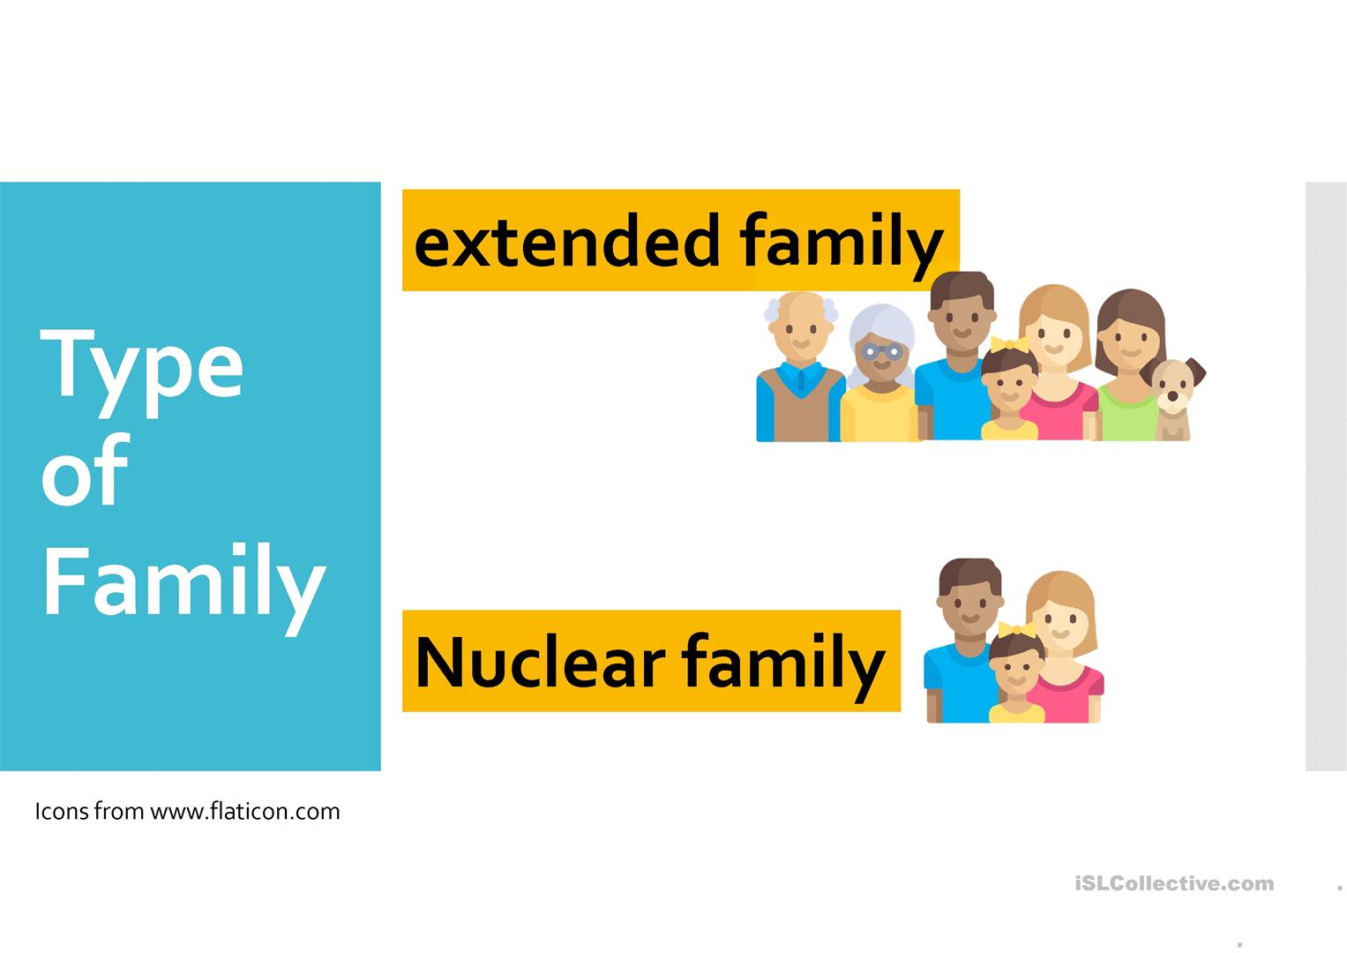
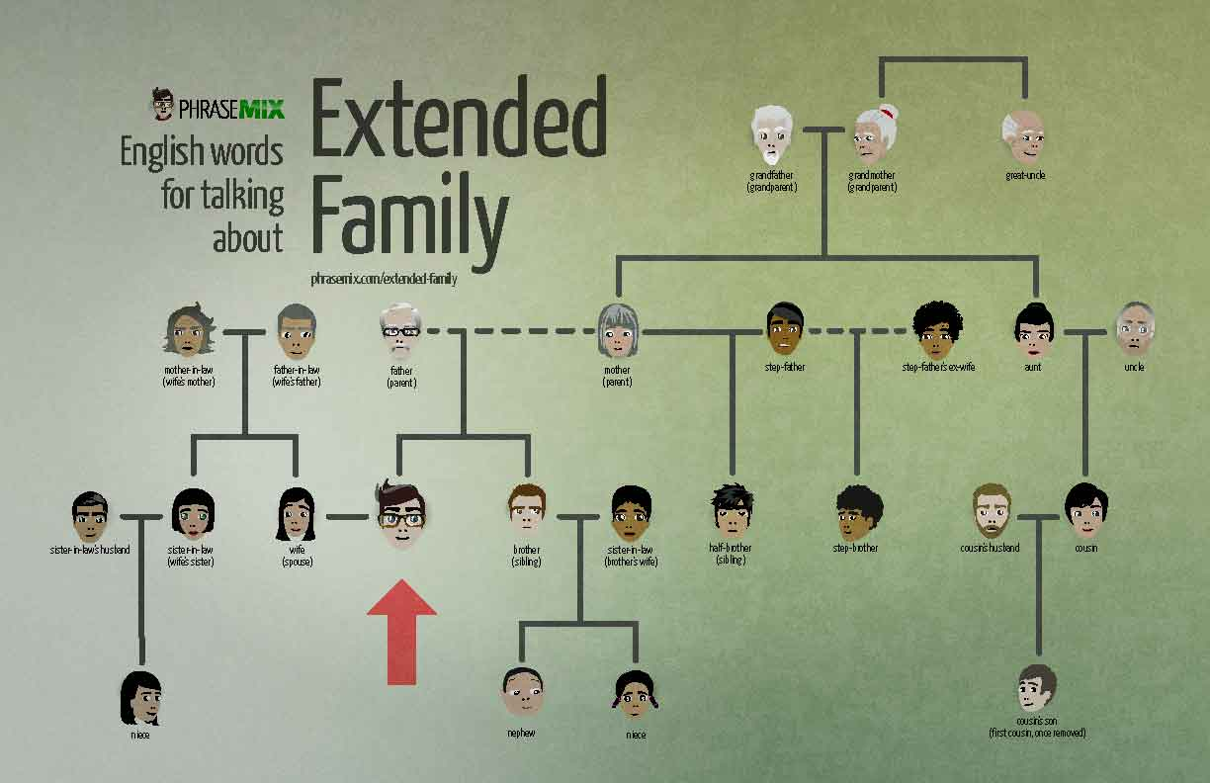
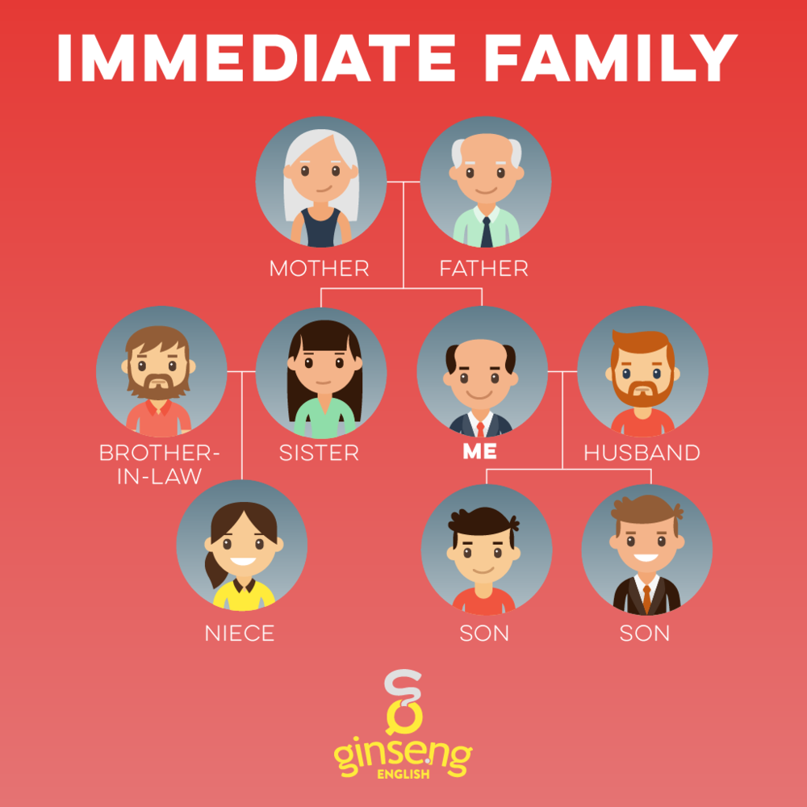
Session 2- Talking about Family
= Nuclear Family
= Immediate Family
https://befluent.me/

Slide 16
Session 2- Talking about Family
Part 3: Speaking Practice
https://befluent.me/

Slide 17
Session 2- Talking about Family
(Like Father, Like Son -Run in the Family- One Big Happy Family -Family Man- A Helicopter Parent)
Answer the following questions using some of the above idioms:
Tell me about your family.
Student :
Correction:
Do you have a big family? / Would you like to have a big or a small family?
Student :
Correction:
Are friends more important than family? What do you think?
Student :
Correction:
What do you think of assigning chores to children in the family?
Student :
Correction:
https://befluent.me/

Slide 18
Session 2- Talking about Family
(Like Father, Like Son -Run in the Family- One Big Happy Family -Family Man- A Helicopter Parent)
Answer the following questions using some of the above idioms:
What do you like doing when you spend time with your family?
Student :
Correction:
Did you ever meet any of your great grandparents?
Student :
Correction:
How did you get your name? Who are you named after?
Student :
Correction:
What is the most important thing your parents taught you?
Student :
Correction:
https://befluent.me/

Slide 19
Session 2- Talking about Family
(Like Father, Like Son -Run in the Family- One Big Happy Family -Family Man- A Helicopter Parent)
Answer the following questions using some of the above idioms:
If you could have a different number of siblings and children, what would it be? Why?
Student :
Correction:
If you were offered an excellent job opportunity abroad, would you consider leaving your family for an indefinite period of time?
Student :
Correction:
https://befluent.me/

Slide 20
Session 2- Talking about Family
(Like Father, Like Son -Run in the Family- One Big Happy Family -Family Man- A Helicopter Parent)
There is much talk recently of increased social problems due to family breakdown. Is this true?
Student :
Correction:
Do you ever get tired of family duties?
Student :
Correction:
Do you consider close friends as family? Explain why?
Student :
Correction:
https://befluent.me/

Slide 21

Session 2- Talking about Family
(Like Father, Like Son -Run in the Family- One Big Happy Family -Family Man- A Helicopter Parent)
Do you like taking photos with your family?
Student :
Correction:
Can you describe this picture?
Student :
Correction:
https://befluent.me/

Slide 22
Session 2- Talking about Family
Thank you!☺
https://befluent.me/

